Slide 1
Lecture VI
Nonlinear Optimisation & Adjoints

Slide 2
1.
The Concept of Iterative Descent Methods

Slide 3

The General Scheme
Our goal: Find a model m such that a suitably defined misfit χ is minimal.
The minimisation proceeds iteratively:
1. Start from initial model
2. Update according to with
step length
descent direction

Slide 4
The General Scheme
Our goal: Find a model m such that a suitably defined misfit χ is minimal.
The minimisation proceeds iteratively:
1. Start from initial model
2. Update according to with
step length
descent direction
χ
m₀
m₁
m

Slide 5
The General Scheme
Our goal: Find a model m such that a suitably defined misfit χ is minimal.
The minimisation proceeds iteratively:
1. Start from initial model
2. Update according to with
step length
descent direction
χ
m₀
m₁
m₂
m₃
m₄
m

Slide 6
The General Scheme
Our goal: Find a model m such that a suitably defined misfit χ is minimal.
The minimisation proceeds iteratively:
1. Start from initial model
2. Update according to with
step length
descent direction
χ
m₀
m₁
m₂
m₃
m₄
m

Slide 7
Derivation of the general descent direction

Slide 8


The General Scheme
Our goal: Find a model m such that a suitably defined misfit χ is minimal.
The minimisation proceeds iteratively:
1. Start from initial model
2. Update according to with
step length
descent direction
A possible descent direction is always:
Other possible directions are for any positive definite matrix A [which may change with iteration].
The members of the descent method family are defined by the choice of A.

Slide 9
2.
Member of Gradient Descent Family

Slide 10
Steepest Descent – The Algorithm

Slide 11
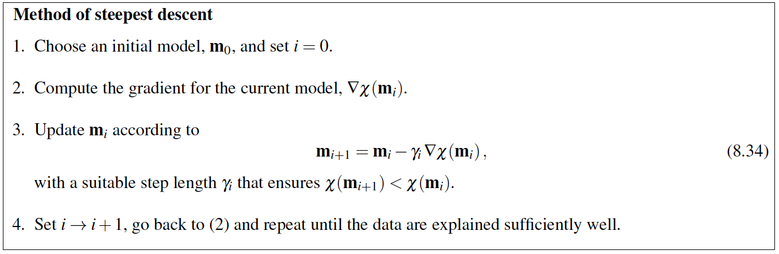
Steepest Descent – The Algorithm
A=I → h is direction of steepest descent

Slide 12
Steepest Descent – Examples
A=I → h is direction of steepest descent

Slide 13
Steepest Descent – Pros & Cons
A=I → h is direction of steepest descent
Very easy to implement.
Method of choice for testing purposes.
Potentially very slow convergence.

Slide 14
Newton’s Method – The Algorithm

Slide 15

Newton’s Method – The Algorithm
Newton‘s method is motivated by a Taylor expansion:
A=H⁻¹, where H is the Hessian [matrix of second derivatives].

Slide 16
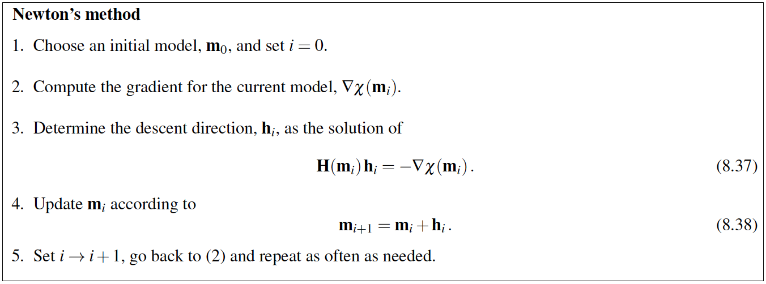
Newton’s Method – The Algorithm
Newton‘s method is motivated by a Taylor expansion:
A=H⁻¹, where H is the Hessian [matrix of second derivatives].

Slide 17
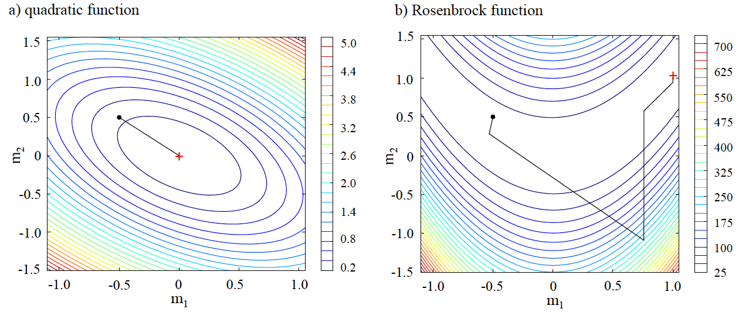
Newton’s Method – Examples
Newton‘s method is motivated by a Taylor expansion:
A=H⁻¹, where H is the Hessian [matrix of second derivatives].

Slide 18
Newton’s Method – Pros & Cons
Newton‘s method is motivated by a Taylor expansion:
A=H⁻¹, where H is the Hessian [matrix of second derivatives].
Converges rapidly. In 1 iteration, when the misfit is quadratic.
Requires computation of second derivatives.
Requires inversion of a potentially big matrix that may not be invertible.

Slide 19
The Spectrum Of Descent Methods
Steepest descent and Newton‘s method: end members in a broad spectrum of gradient-based descent methods
method of steepest descent
Newton’s method
algorithmically simple
slow convergence
algorithmically complex
fast convergence

Slide 20
The Spectrum Of Descent Methods
Steepest descent and Newton‘s method: end members in a broad spectrum of gradient-based descent methods
method of steepest descent
conjugate gradients
Newton’s method
...
...
BFGS
...
L-BFGS
...
algorithmically simple
slow convergence
algorithmically complex
fast convergence

Slide 21
Conjugate Gradients

Slide 22
Conjugate Gradients
Steepest descent tends to go again and again in a similar direction. → Makes it pretty inefficient.
Steepest-descent minimisation of the Rosenbrock function

Slide 23
Conjugate Gradients
Steepest descent tends to go again and again in a similar direction. → Makes it pretty inefficient.
Basic idea of conjugate gradients: March in directions that are mutually orthogonal in the sense of h_{i}Hh_{i+1}=0.

Slide 24
Conjugate Gradients
Steepest descent tends to go again and again in a similar direction. → Makes it pretty inefficient.
Basic idea of conjugate gradients: March in directions that are mutually orthogonal in the sense of h_{i}Hh_{i+1}=0.
The conjugate-gradient method constructs a sequence of orthogonal descent directions, h₀, h₁, ..., automatically.
There are different ways of doing that, and each of these ways has its own name:
Fletcher-Reves method
Hestenes-Stiefel method
Polak-Ribiere method

Slide 25
Conjugate Gradients
Steepest descent tends to go again and again in a similar direction. → Makes it pretty inefficient.
Basic idea of conjugate gradients: March in directions that are mutually orthogonal in the sense of h_{i}Hh_{i+1}=0.
The conjugate-gradient method constructs a sequence of orthogonal descent directions, h₀, h₁, ..., automatically.
There are different ways of doing that, and each of these ways has its own name:
Fletcher-Reves method
Hestenes-Stiefel method
Polak-Ribiere method
The conjugate-gradient method for exactly quadratic misfit functions:
Converges in n steps at most because:
H is constant and there are only n mutually orthogonal directions.

Slide 26
Conjugate Gradients
Steepest descent tends to go again and again in a similar direction. → Makes it pretty inefficient.
Basic idea of conjugate gradients: March in directions that are mutually orthogonal in the sense of h_{i}Hh_{i+1}=0.
The conjugate-gradient method constructs a sequence of orthogonal descent directions, h₀, h₁, ..., automatically.
There are different ways of doing that, and each of these ways has its own name:
Fletcher-Reves method
Hestenes-Stiefel method
Polak-Ribiere method
The conjugate-gradient method for exactly quadratic misfit functions:
Converges in n steps at most because:
H is constant and there are only n mutually orthogonal directions.
The conjugate-gradient method for general misfit functions:
Is basically a leap of faith.
Tends to converge more quickly than steepest descent for many applications.

Slide 27
Conjugate Gradients
Steepest descent tends to go again and again in a similar direction. → Makes it pretty inefficient.
Basic idea of conjugate gradients: March in directions that are mutually orthogonal in the sense of h_{i}Hh_{i+1}=0.

Slide 28
BFGS Method [Broyden, Fletcher, Goldfarb, Shanno]

Slide 29
BFGS Method [Broyden, Fletcher, Goldfarb, Shanno]
The Newton method converges quickly because it uses second-derivative information in the form of H⁻¹.
Second derivatives are really difficult to compute! And H is difficult to invert!
Basic idea of the BFGS method: Construct an approximation of H⁻¹ as we march through model space.

Slide 30
BFGS Method [Broyden, Fletcher, Goldfarb, Shanno]
The Newton method converges quickly because it uses second-derivative information in the form of H⁻¹.
Second derivatives are really difficult to compute! And H is difficult to invert!
Basic idea of the BFGS method: Construct an approximation of H⁻¹ as we march through model space.
0th approximation of H⁻¹ = I
m₀

Slide 31
BFGS Method [Broyden, Fletcher, Goldfarb, Shanno]
The Newton method converges quickly because it uses second-derivative information in the form of H⁻¹.
Second derivatives are really difficult to compute! And H is difficult to invert!
Basic idea of the BFGS method: Construct an approximation of H⁻¹ as we march through model space.
1st approximation of H⁻¹ = A₁
based on m₀, m₁
m₀
m₁

Slide 32
BFGS Method [Broyden, Fletcher, Goldfarb, Shanno]
The Newton method converges quickly because it uses second-derivative information in the form of H⁻¹.
Second derivatives are really difficult to compute! And H is difficult to invert!
Basic idea of the BFGS method: Construct an approximation of H⁻¹ as we march through model space.
2nd approximation of H⁻¹ = A₂
based on m₀, m₁, m₂
m₀
m₁
m₂

Slide 33
BFGS Method [Broyden, Fletcher, Goldfarb, Shanno]
The Newton method converges quickly because it uses second-derivative information in the form of H⁻¹.
Second derivatives are really difficult to compute! And H is difficult to invert!
Basic idea of the BFGS method: Construct an approximation of H⁻¹ as we march through model space.
3rd approximation of H⁻¹ = A₃
based on m₀, m₁, m₂, m₃
m₀
m₁
m₂
m₃

Slide 34
BFGS Method [Broyden, Fletcher, Goldfarb, Shanno]
The Newton method converges quickly because it uses second-derivative information in the form of H⁻¹.
Second derivatives are really difficult to compute! And H is difficult to invert!
Basic idea of the BFGS method: Construct an approximation of H⁻¹ as we march through model space.
4th approximation of H⁻¹ = A₄
based on m₀, m₁, m₂, m₃, m₄
m₀
m₁
m₂
m₃
m₄

Slide 35
BFGS Method [Broyden, Fletcher, Goldfarb, Shanno]
The Newton method converges quickly because it uses second-derivative information in the form of H⁻¹.
Second derivatives are really difficult to compute! And H is difficult to invert!
Basic idea of the BFGS method: Construct an approximation of H⁻¹ as we march through model space.
5th approximation of H⁻¹ = A₅
based on m₀, m₁, m₂, m₃, m₄, m₅
m₀
m₁
m₂
m₅
m₃
m₄

Slide 36
BFGS Method [Broyden, Fletcher, Goldfarb, Shanno]
The Newton method converges quickly because it uses second-derivative information in the form of H⁻¹.
Second derivatives are really difficult to compute! And H is difficult to invert!
Basic idea of the BFGS method: Construct an approximation of H⁻¹ as we march through model space.
6th approximation of H⁻¹ = A₆
based on m₀, m₁, m₂, m₃, m₄, m₅, m₆
m₀
m₁
m₆
m₂
m₅
m₃
m₄

Slide 37
BFGS Method [Broyden, Fletcher, Goldfarb, Shanno]
The Newton method converges quickly because it uses second-derivative information in the form of H⁻¹.
Second derivatives are really difficult to compute! And H is difficult to invert!
Basic idea of the BFGS method: Construct an approximation of H⁻¹ as we march through model space.
7th approximation of H⁻¹ = A₇
based on m₀, m₁, m₂, m₃, m₄, m₅, m₆, m₇
m₀
m₁
m₆
m₇
m₂
m₅
m₃
m₄

Slide 38
BFGS Method [Broyden, Fletcher, Goldfarb, Shanno]
The Newton method converges quickly because it uses second-derivative information in the form of H⁻¹.
Second derivatives are really difficult to compute! And H is difficult to invert!
Basic idea of the BFGS method: Construct an approximation of H⁻¹ as we march through model space.
For exactly quadratic misfit functions:
A_{n}=H⁻¹ [after n iterations we get the exact inverse Hessian]
Descent directions are mutually orthogonal, as in conjugate-gradient methods → convergence after n iterations.
For general misfit functions: leap of faith but empirically very efficient in many cases.
Behaviour for test functions: See Jupyter notebook!

Slide 39
L-BFGS Method

Slide 40
L-BFGS Method
The BFGS method requires a lot of storage [matrix A_{i}].
Basic idea of the L-BFGS method: Just do not use all of the models along the path!

Slide 41
L-BFGS Method
The BFGS method requires a lot of storage [matrix A_{i}].
Basic idea of the L-BFGS method: Just do not use all of the models along the path!
0th approximation of H⁻¹ = I
m₀

Slide 42
L-BFGS Method
The BFGS method requires a lot of storage [matrix A_{i}].
Basic idea of the L-BFGS method: Just do not use all of the models along the path!
1st approximation of H⁻¹ = A₁
based on m₀, m₁
m₀
m₁

Slide 43
L-BFGS Method
The BFGS method requires a lot of storage [matrix A_{i}].
Basic idea of the L-BFGS method: Just do not use all of the models along the path!
2nd approximation of H⁻¹ = A₂
based on m₀, m₁, m₂
m₀
m₁
m₂

Slide 44
L-BFGS Method
The BFGS method requires a lot of storage [matrix A_{i}].
Basic idea of the L-BFGS method: Just do not use all of the models along the path!
3rd approximation of H⁻¹ = A₃
based on m₁, m₂, m₃
m₁
m₂
m₃

Slide 45
L-BFGS Method
The BFGS method requires a lot of storage [matrix A_{i}].
Basic idea of the L-BFGS method: Just do not use all of the models along the path!
4th approximation of H⁻¹ = A₄
based on m₂, m₃, m₄
m₂
m₃
m₄

Slide 46
L-BFGS Method
The BFGS method requires a lot of storage [matrix A_{i}].
Basic idea of the L-BFGS method: Just do not use all of the models along the path!
5th approximation of H⁻¹ = A₅
based on m₃, m₄, m₅
m₅
m₃
m₄

Slide 47
L-BFGS Method
The BFGS method requires a lot of storage [matrix A_{i}].
Basic idea of the L-BFGS method: Just do not use all of the models along the path!
6th approximation of H⁻¹ = A₆
based on m₄, m₅, m₆
m₆
m₅
m₄

Slide 48
L-BFGS Method
The BFGS method requires a lot of storage [matrix A_{i}].
Basic idea of the L-BFGS method: Just do not use all of the models along the path!
7th approximation of H⁻¹ = A₇
based on m₅, m₆, m₇
m₆
m₇
m₅

Slide 49
L-BFGS Method
The BFGS method requires a lot of storage [matrix A_{i}].
Basic idea of the L-BFGS method: Just do not use all of the models along the path!
More difficult to implement than the other methods.
Empirically hard to beat in the large-scale inverse problems that we deal with!
Behaviour for test functions: See Jupyter Notebook!

Slide 50
3.
Adjoint Method Crash Course

Slide 51
So, Where Is The Problem?
The full gradient – with all its components - is needed in each iteration.
The most straightforward approach: approximate the gradient by finite-differences:
Example with 500,000 model parameters:
500,001 forward simulations
× 0.5 h per simulation
× 126 compute cores
× 50 sources (earthquakes)
× 50 conjugate gradient iterations
78e⁹ cpu hours ≈ 8,900,000 cpu years

Slide 52
Derivation of discrete adjoints

Slide 53
Discrete Adjoint Method Summary
Regular wave equation
Adjoint wave equation
Gradient equation

Slide 54
Discrete Adjoint Method Summary
Regular wave equation
Adjoint wave equation
Gradient equation
Adjoint recipe
Solve forward problem [regular wave equation] to obtain u.
Evaluate misfit χ.
Compute adjoint source, -∨χ.
Solve adjoint equation to obtain adjoint field v.
Plug u and v into the gradient equation.

Slide 55
Discrete Adjoint Method Summary
Regular wave equation
Adjoint wave equation
Gradient equation
Adjoint recipe
Solve forward problem [regular wave equation] to obtain u.
Evaluate misfit χ.
Compute adjoint source, -∨χ.
Solve adjoint equation to obtain adjoint field v.
Plug u and v into the gradient equation.
Comments
No need to explicitly compute the derivative of the wavefield u [by construction].
Gradient is entirely determined by the definition of the misfit [adjoint source is the only thing that explicitly depends on the misfit].
Computation of gradient requires storage of forward wavefield u.

Slide 56
Example

Slide 57
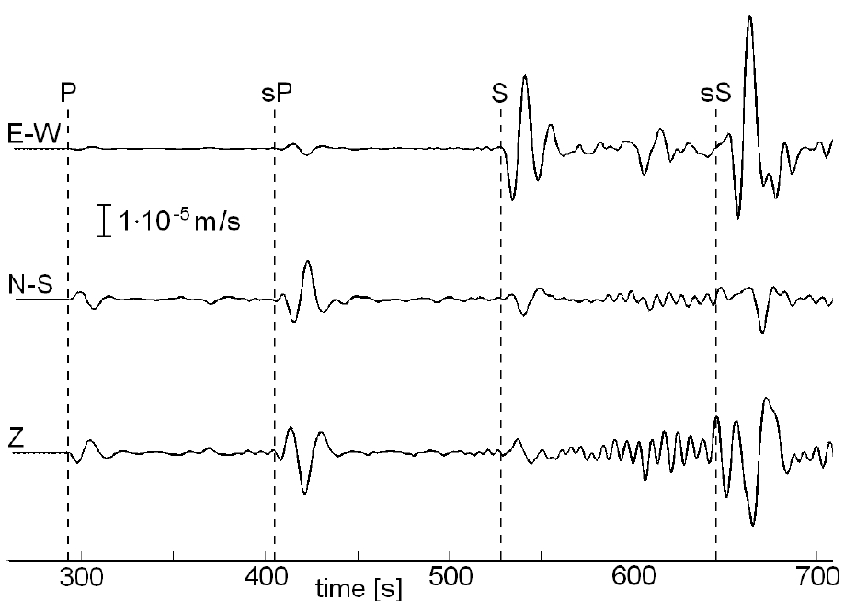
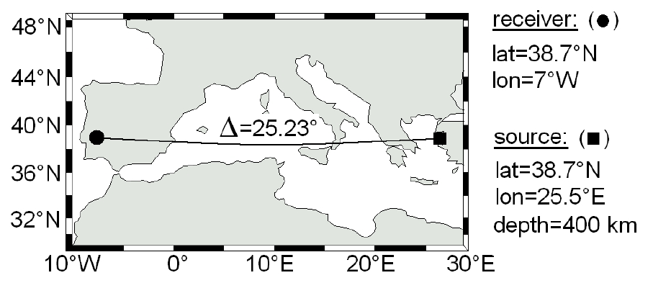
Example
Source-receiver geometry
Seismograms

Slide 58
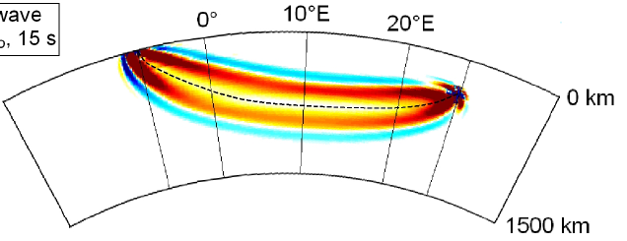
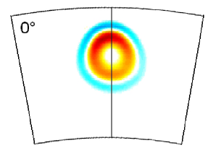
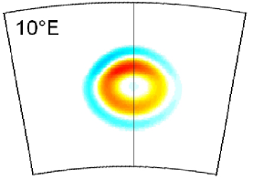
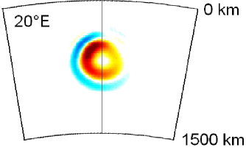
Example
Source-receiver geometry
Seismograms
Sensitivity kernel for P wave velocity
receiver
source
-
+

Slide 59
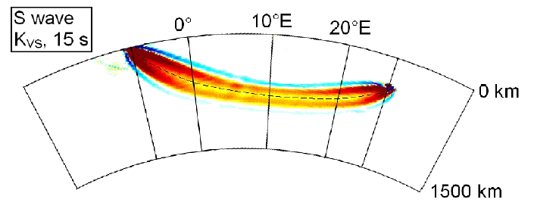
Example
Source-receiver geometry
Seismograms
Sensitivity kernel for S wave velocity
-
+

Slide 60
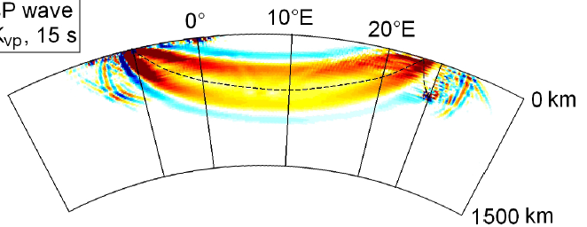
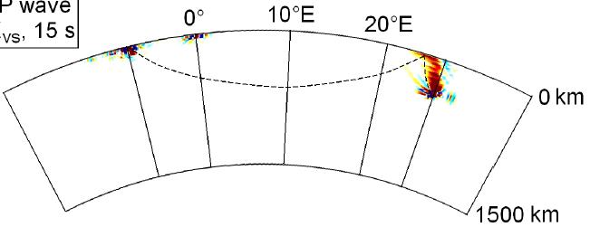
Example
Source-receiver geometry
Seismograms
Sensitivity kernels for
P wave velocity and S wave velocity
-
+

Slide 61
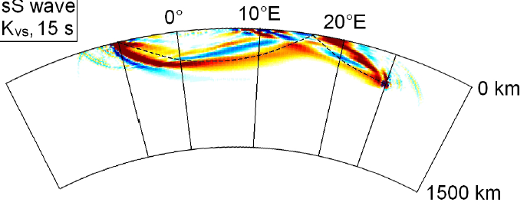
Example
Source-receiver geometry
Seismograms
Sensitivity kernel for S wave velocity
-
+

